Slide 1
How to Get Into Medical School in Australia
Admissions 101

Slide 2
Studying Medicine or Rehab Sciences in Australia
Admissions 101
Notes:
For med and rehab sci combo presentations

Slide 3
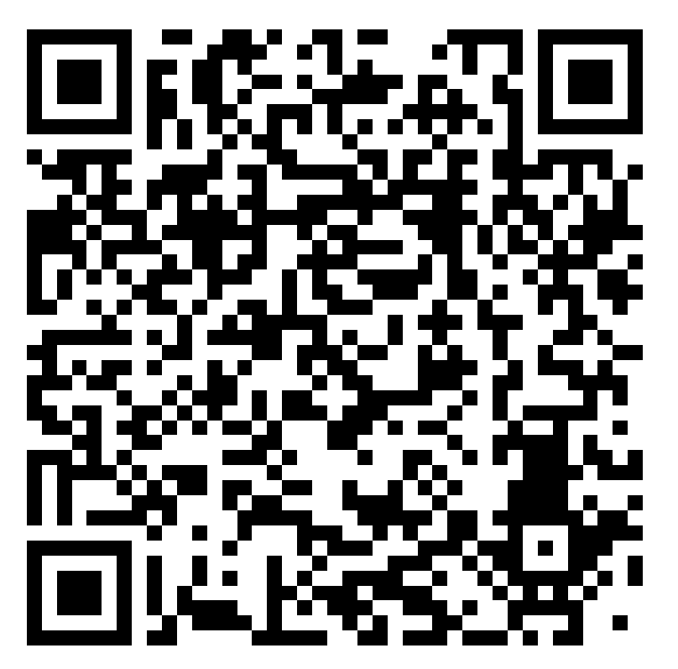
WEBINAR
October 24, 2023
7 – 8 p.m. ET
All registrants will receive the recording

Slide 4
About OzTREKK
Why Australia
Degrees & Universities
Admissions Criteria
After You Graduate
Get in Touch!

Slide 5
How OzTREKK Helps
OzTREKK HELPS YOU GET FROM EH TO OZ—FOR FREE!
Help you determine if you’re eligible and competitive to apply
Apply online to multiple universities at once
Certify transcripts and submit your apps to the universities
We assess and advocate for each student as needed
We help you accept and get ready to go

Slide 6
Understanding Licensing
In-person and online medical licensing presentations
Understanding pathways
Licensing exams
COMING HOME TO PRACTICE
Notes:
This is part of “What does OzTREKK do?”

Slide 7
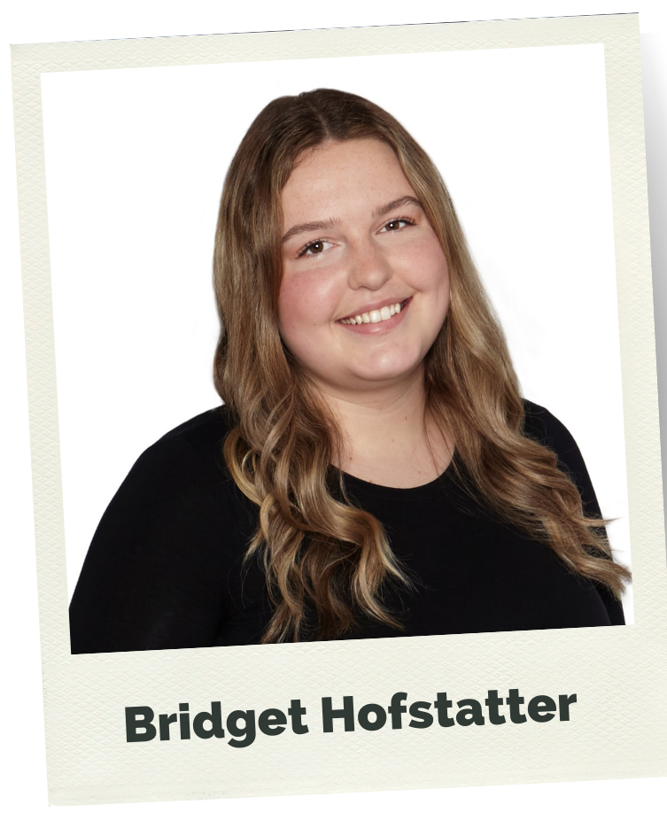
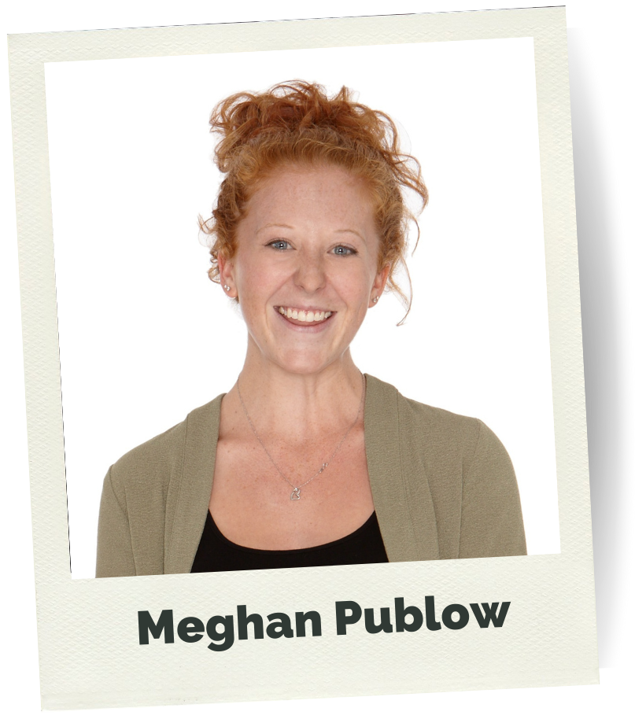
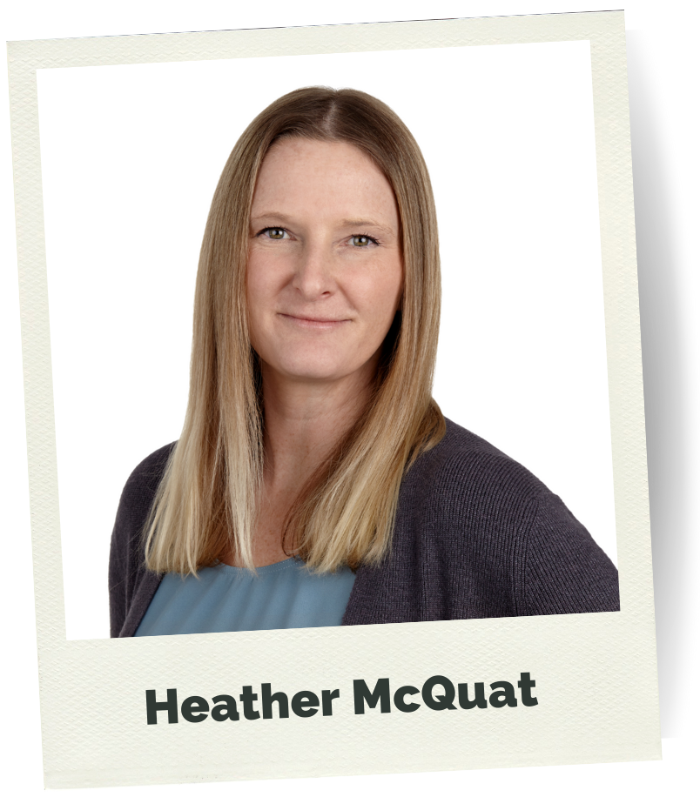
OzTREKK’s Medicine
ADMISSIONS TEAM
medicine@oztrekk.com
Notes:
Reach out to your admissions team if you have any questions along the way.

Slide 8
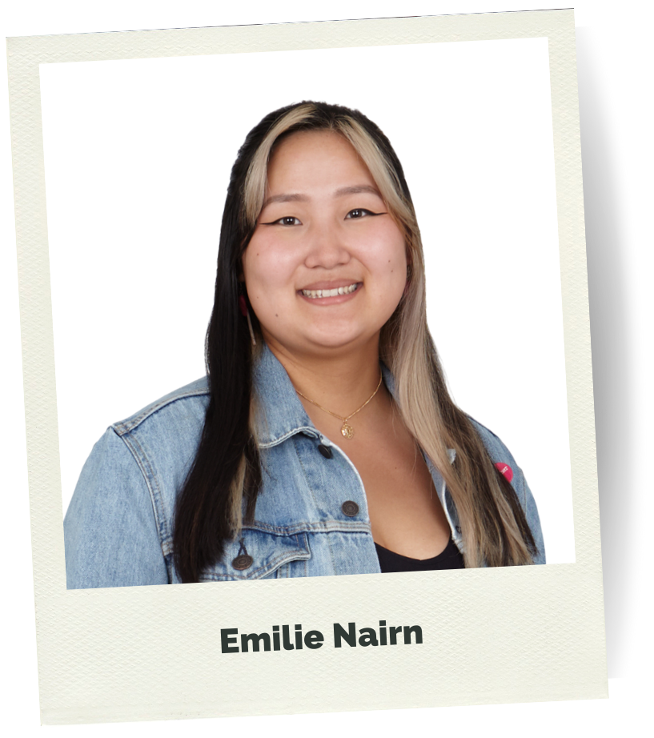
OzTREKK’s Medicine
ADMISSIONS TEAM
medicine@oztrekk.com

Slide 9
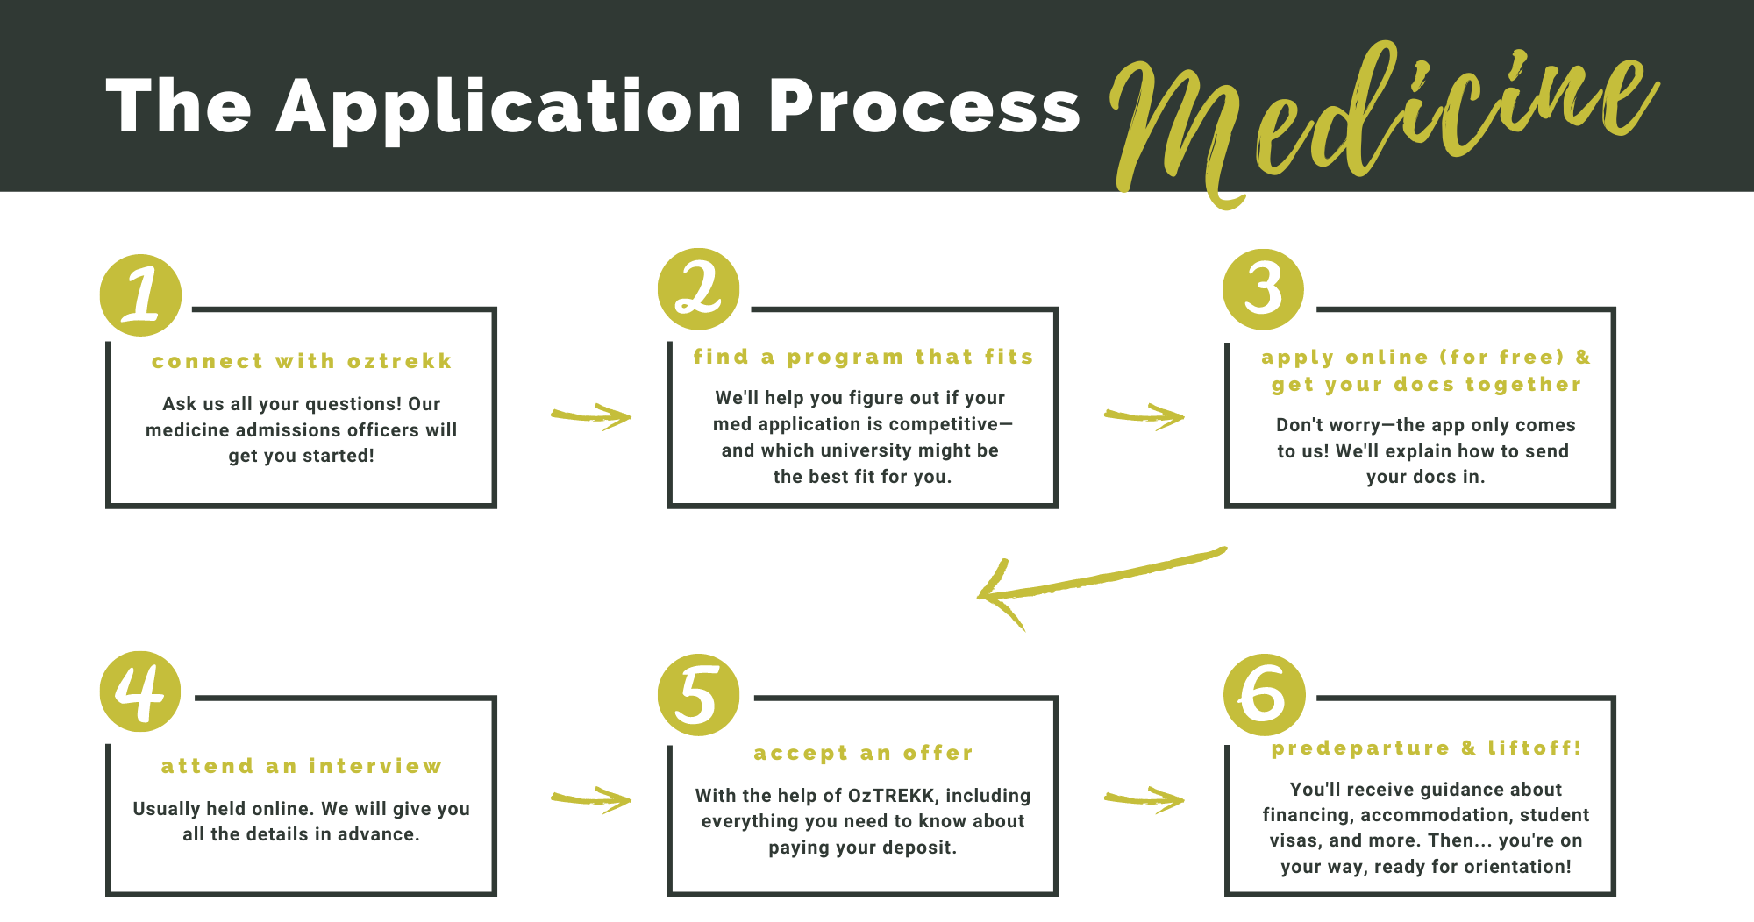
Notes:
*Straightforward process with ample support

Slide 10
AUSTRALIA
Notes:
Beautiful Melbourne and Yarra River!

Slide 11
Why Australia?
23 million, diverse population
Similar to Canada: size, healthcare, education, legal system
English-speaking
Ranks in “Most Liveable Cities” in the world
Amazing climate
Medical schools have prestigious global reputation
THERE’S A LOT MORE TO AUSTRALIA THAN GREAT BEACHES…
Notes:
Generic version – good for all programs

Slide 12
Why Study in Australia?
Limited places at Canadian unis
Prestigious global reputation
Can return to practice in Canada
Student support/hands-on approach
Beautiful climate, beaches, and cities
Adventurous outdoor lifestyle
Notes:
Brisbane

Slide 13
Notes:
Many OzTREKK students spend their vacation time travelling Oz!
Amanda’s notes: Feel free to tell people I’ve travelled a lot in Aus and am always happy to chat about locations

Slide 14
Med schools in AUSTRALIA
Notes:
Melbourne shown

Slide 15
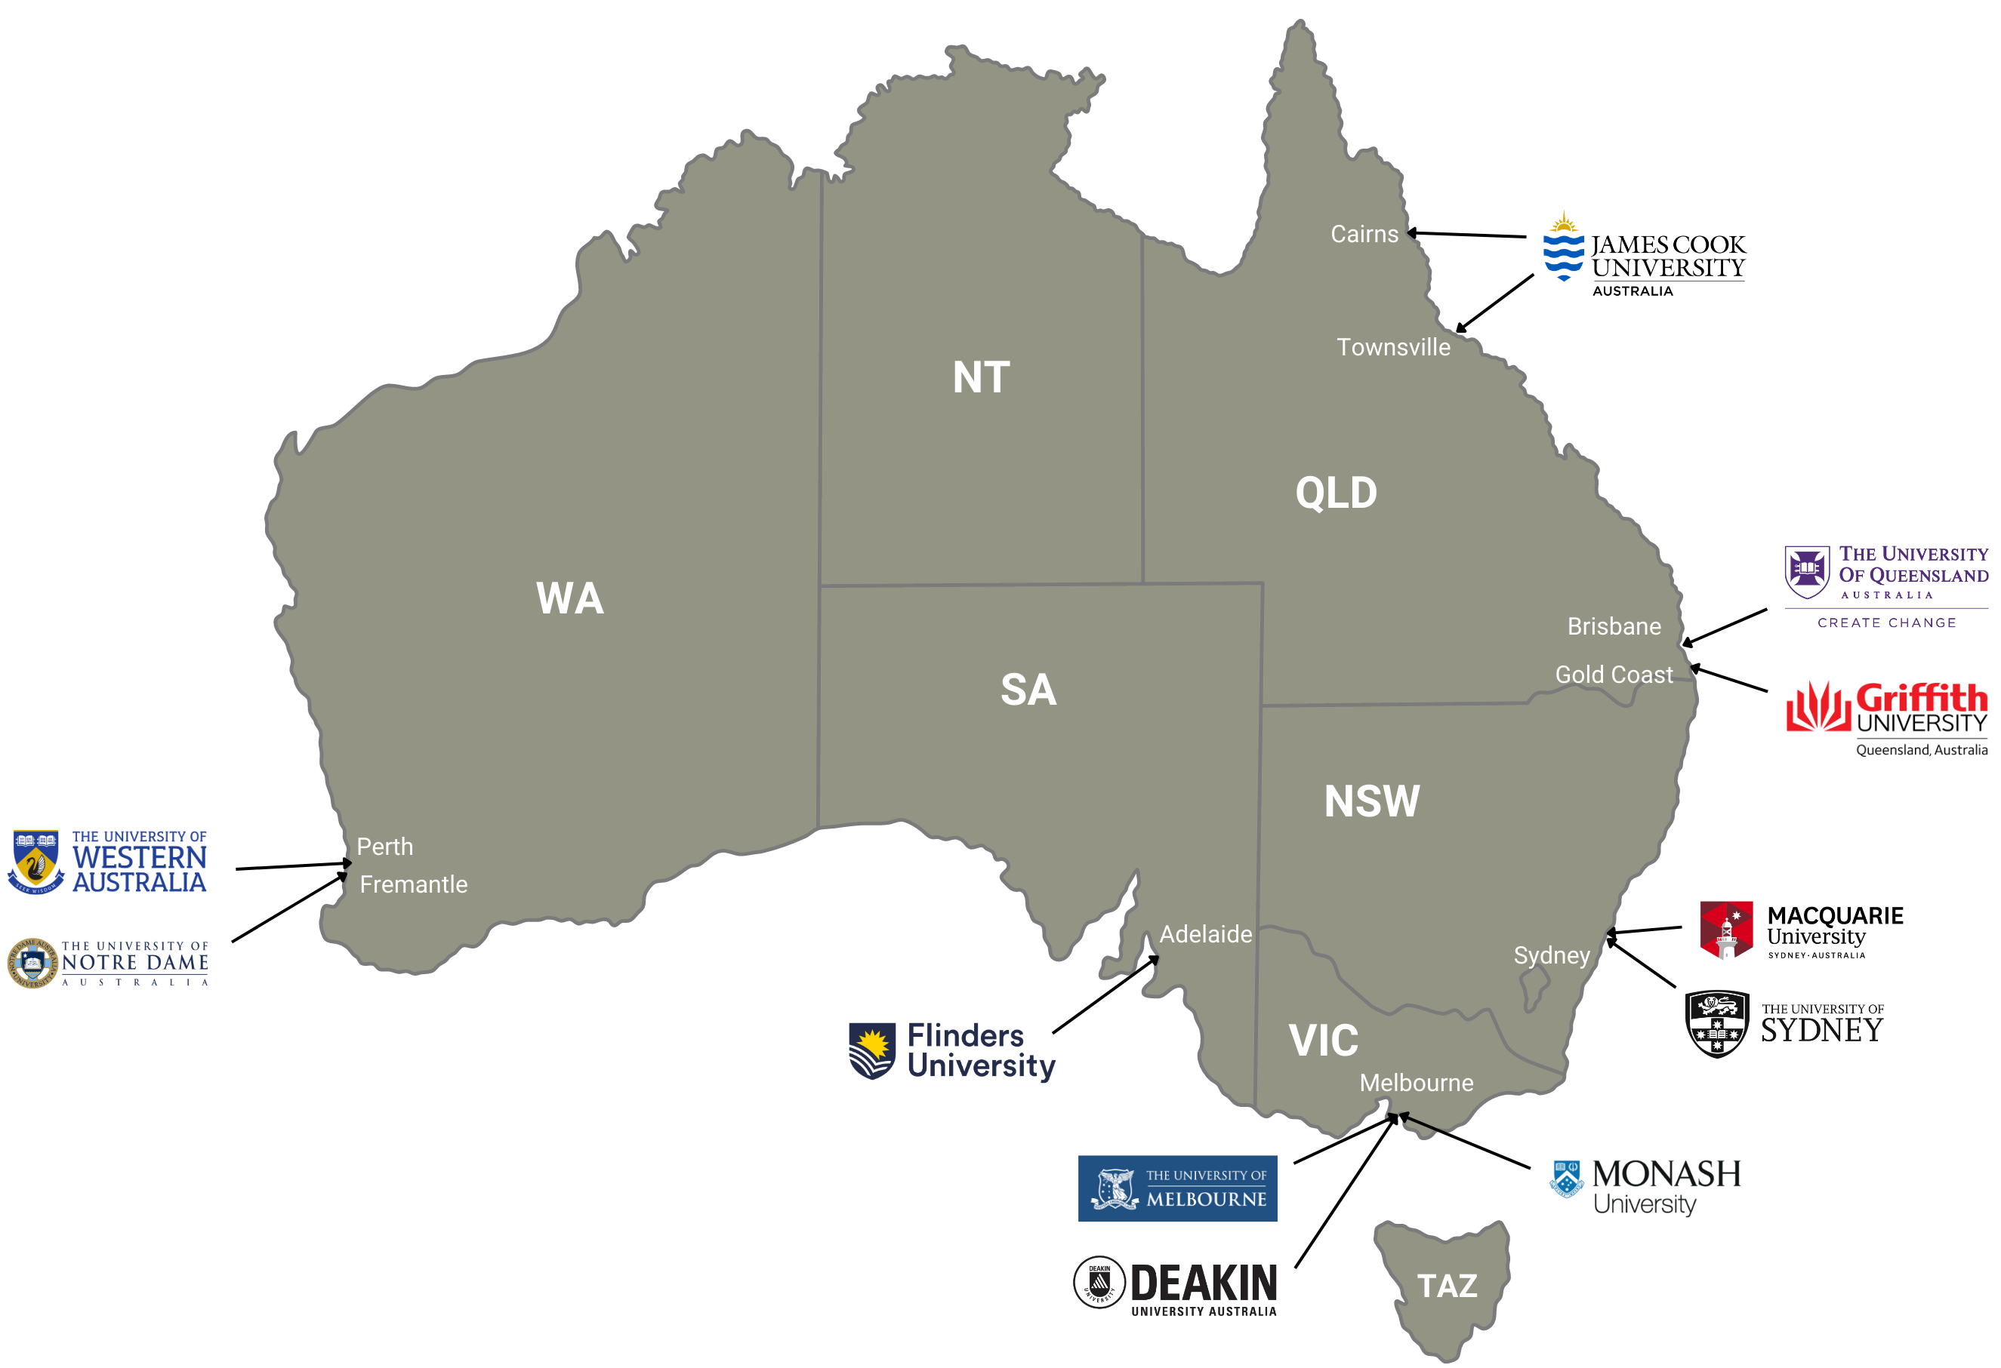
OzTREKK’s University Partners
11 medical schools
9 options for students in final semester or with completed degrees
6 undergrad options for students applying directly from high school
2 undergrad options for students with partially completed bachelor’s degrees
Notes:
*We work very closely with each of our university partners, and can advocate on behalf of our students
MD – 4 years
UG – 5 or 6 years
6 of OzTREKK's Australian universities have medicine programs which it is possible to enter directly from high school and lead to an MD or equivalent qualification. These include:
-Standalone single degree medicine programs (JCU and Monash)
-Combined degrees offer a guaranteed pathway to an MD, as entry requirements for both degrees are met at the initial offer stage, and progression through the program is based on passing with a minimum GPA.
-UG programs: Only JCU and Macquarie allow post-graduate studies for entry (i.e., you can’t have any post-secondary studies to enter all the others. High school only and no more than 2 years previous)
***AMANDA SAYS: I like to keep my students focused on 5 or less applications at a time. To keep them focused and to make the process as smooth as possible.

Slide 16
1,699
545
Apps Submitted
Offers Received
GRADUATEMEDICINE
506
3.5
Competitive MCAT
Competitive GPA
2023 INTAKE
Notes:
Numbers from 2023 intake eligibility chart

Slide 17
180
71
Apps Submitted
Offers Received
UNDERGRADMEDICINE
Best 4–6
94%
Grade 12 Subjects
Competitive GPA
2023 INTAKE
Notes:
Numbers from 2023 intake eligibility chart

Slide 18
Medical School Rankings
Canada
Australia
#15 University of Toronto
#22 McGill University
#28 University of British Columbia
#40 McMaster University
#24 University of Sydney
#25 University of Melbourne
#40 Monash University
#59 University of Queensland
QS World Rankings by Subject – Medicine 2023

Slide 19
Fast Facts: Graduate-entry
PROGRAM DURATION | MD (4 years)
GPA REQUIREMENTS | 2.7 / 70%+ minimum
ADMISSIONS TEST | MCAT 497 minimum to apply
NUMBER OF INTERNATIONAL PLACES | 5 – 90
INTERVIEWS | Online & in-person in Canada
WHEN TO APPLY | January – May (year before)
PROGRAMS START | January – February
GRADUATE TUITION | $77,400 – $96,000 AUD (2023 fees)
Notes:
Julie says: I think this slide should show MINIMUMS (we have a slide that shows competitive)
Speak with the OzTREKK Medicine Team to learn where you are eligible and competitive.

Slide 20
Graduate Entry Am I Eligible & Competitive?
YOU’LL NEED A COMPLETED BACHELOR’S DEGREE
UNIVERSITY | MINIMUM MCAT SCORES
Deakin University | 125 in each section
University of Queensland | 504 overall
University of Sydney | 500 overall
Macquarie University | 500 overall
University of Notre Dame | 500 overall
University of Western Australia | 500 overall 124 in each section
Griffith University | 123 in each section
Flinders University | 123 in each section
University of Melbourne | 492 overall
Monash University | No MCAT required
Minimum GPA 70%+
Bachelor’s degrees: 80%+ depending on the uni
Prerequisite Subjects
Monash + UQ
Minimum MCAT
Aim for 507+
Notes:
The main basis of assessment for the graduate entry medical schools that we represent is on GPA, MCAT and interview. FOR THE MD’s Supplementary documents such as a personal statement, reference letters, etc., will not be considered in the assessment process. Don’t stress about your extracurriculars!
A completed bachelor’s degree within the last 10 years, if you graduated more than 10 years ago, please contact me to discuss your options. It doesn’t have to be a science degree.
If you have a master’s degree some of the universities will use it in your assessment, some will not.
A minimum cumulative GPA of 70% in your university studies Get your academic advisor to tell you your GPA!
I do want to be sure that you know that OzTREKK does not perform official GPA calculations and that is completed by the universities. There is no direct conversion onto the 4.0 scale here in Canada, however, I generally advise students to have a minimum of 70% or 2.7/4.0 and an 80% to be competitive.
MCAT if you do have below a 505, please contact me and I will share where I believe you can apply!

Slide 21
Graduate-entry Medicine
UNIVERSITY | MINIMUM MCAT SCORES | COMPETITIVE MCAT 2023
Deakin University | 125 in each section | 505
Flinders University | 123 in each section | 501
Griffith University | 123 in each section | 503
Macquarie University | 500 overall | 505
Monash University | N/A | N/A
University of Melbourne | 505 overall* | 507
University of Notre Dame Australia | 500 overall | N/A
University of Queensland | 504 overall | 506
University of Sydney | 505* overall | 513
University of Western Australia | 500 overall; 124 in each section | 507
GPA
MIN 70% + | COMPETITIVE 80% +
MCAT
Aim for 507+
Prerequisite Subjects
Monash + UQ
*OzTREKK minimums. See competitive stats on our website.
Notes:
https://oztrekk.com/resources/eligibility/
The main basis of assessment for the graduate entry medical schools that we represent is on GPA, MCAT and interview. FOR THE MDs supplementary documents such as a personal statement, reference letters, etc., will not be considered in the assessment process. Don’t stress about your extracurriculars!
A completed bachelor’s degree within the last 10 years, if you graduated more than 10 years ago, please contact me to discuss your options. It doesn’t have to be a science degree.
If you have a master’s degree some of the universities will use it in your assessment, some will not.
A minimum cumulative GPA of 70% in your university studies Get your academic advisor to tell you your GPA!
I do want to be sure that you know that OzTREKK does not perform official GPA calculations and that is completed by the universities. There is no direct conversion onto the 4.0 scale here in Canada, however, I generally advise students to have a minimum of 70% or 2.7/4.0 and an 80% to be competitive.
MCAT if you do have below a 505, please contact me and I will share where I believe you can apply!

Slide 22
How Universities Assesses
UNIVERSITY | FOR AN INTERVIEW | FOR AN OFFER
Deakin University | 50/50 - GPA & MCAT | 25% GPA | 25% MCAT | 50% MMI
Flinders University | Aims to schedule all applicants | 33% GPA | 33% MCAT | 33% MMI
Griffith University | 50/50 - GPA & MCAT | Interview score + GPA/test combined rank ÷ 2
Macquarie University | 50/50 - GPA & MCAT (supp form hurdle) | 50% GPA | 50% MMI
Monash University | GPA used to rank applicants | 40% GPA | 60% MMI
University of Melbourne | 50/50 - GPA & MCAT | 25% GPA | 25% MCAT | 50% MMI
University of Notre Dame | 50/50 - GPA & MCAT | 50% GPA | 50% MMI
University of Queensland | 50/50 - GPA & MCAT | 25% GPA | 25% MCAT | 50% MMI
University of Sydney | N/A | MCAT
University of Western Australia | 50/50 - GPA & MCAT | 30% GPA | 20% MCAT | 50% MMI
Notes:
Griffith - Once the interview has been held the interview score will be added to the GPA/Test combined rank and divided by 2 to provide a rank score used to determine whether applicants are eligible for an offer of a place in the program.

Slide 23
Fast Facts: Undergrad-entry
PROGRAM DURATION | 6 years; 2 + 4 years; 3+ 3 years
GPA REQUIREMENTS | 86%+ minimum
ADMISSIONS TEST | ISAT (for 2 programs only)
NUMBER OF INTERNATIONAL PLACES | 13 – 70
INTERVIEWS | Online
WHEN TO APPLY | January – May (year before)
PROGRAMS START | February
UNDERGRADUATE TUITION | $35,000 – $87,000 AUD (2023 fees)
Notes:
Julie says: I think this slide should show MINIMUMS (we have a slide that shows competitive)
*GPA – minimums shown; varies by university (for UG, JCU’s 86% is the lowest GPA)

Slide 24
Undergraduate-entry Medicine
Minimum GPA 86%+
Undergrad programs can be highly competitive; closer to mid-90s is considered competitive
for most.
Prerequisite Subjects
Grade 12 English, chemistry, and math
YOU’LL NEED A COMPLETED HIGH SCHOOL DIPLOMA
ISAT
Required by 2 of the 6 undergrad programs (Monash & UWA)
Notes:
You must have the following:
A completed bachelor’s degree within the last 10 years, if you graduated more than 10 years ago, please contact me to discuss your options
A minimum cumulative GPA of 70% in your university studies Get your academic advisor to tell you your GPA
I do want to be sure that you know that OzTREKK does not perform official GPA calculations and that is completed by the universities. There is no direct conversion onto the 4.0 scale here in Canada, however, I generally advise students to have a minimum of 70% or 2.7/4.0 and an 80% to be competitive.
Here is a look at all the MCAT averages and ranges from each university. This is based on the OzTREKK students who received Letters of Offers for 1-2020:
University
Total Offer Record
Average MCAT
Maximum MCAT
Minimum MCAT
Deakin University
26
509
518
503
Flinders University
41
506
519
496
Griffith University
79
508
521
494
Macquarie University
12
505
511
502
University of Melbourne
27
507
518
493
University of Sydney
72
504*
525
504
University of Queensland
111
510
525
504
University of Western Australia
26
510
520
495
*Sydney – the 504 was a student off the waitlist, so a 505 was really the minimum score if we do not consider the waitlist.

Slide 25
Undergraduate Entry
UNIVERSITY | MINIMUM ISAT SCORES | COMPETITVE GPA 2023
Flinders University | N/A | 96%
Griffith University | N/A | 88%
James Cook University | N/A | 95%
Macquarie University | N/A | 95%+
Monash University | 170+ overall score | 95%+
University of Western Australia | 25 percentile in each section | 90%+
Minimum GPA
High School 86%+
University 82%+
Competitive GPA
High School 86%+
University 82%+
Competitive ISAT
Aim for 180+
Prerequisite Subjects
Grade 12 English, chemistry, and math

Slide 26
General Application Timeline
JAN – FEB
MARCH – MAY
MAY – AUG
SEP – DEC
JAN – FEB
Start your application(s)!
Get your docs
to OzTREKK
Med licensing and interviews
Offers, acceptances, and predeparture
Orientation
Classes begin
Notes:
*Differs from that in Canada!

Slide 27
Coming home

Slide 28
After Graduation
#1 RETURN TO CANADA
#2 COMPLETE PG TRAINING IN AUS
#3 STAY IN AUSTRALIA
#4 GO TO
UNITED STATES
For the match after graduation
Return as a doctor
To complete internship
& practice as a doctor
After med school
Notes:
*You have options after graduation; you will practice SOMEWHERE
1: return for the match
2: complete PG training in Australia, return as a doctor
3: complete internship, return for the match
4: match in the US match
Speaker note: we need to stress that everyone is here for #1 but they need to understand the others as most students are choosing #2 or #3

Slide 29
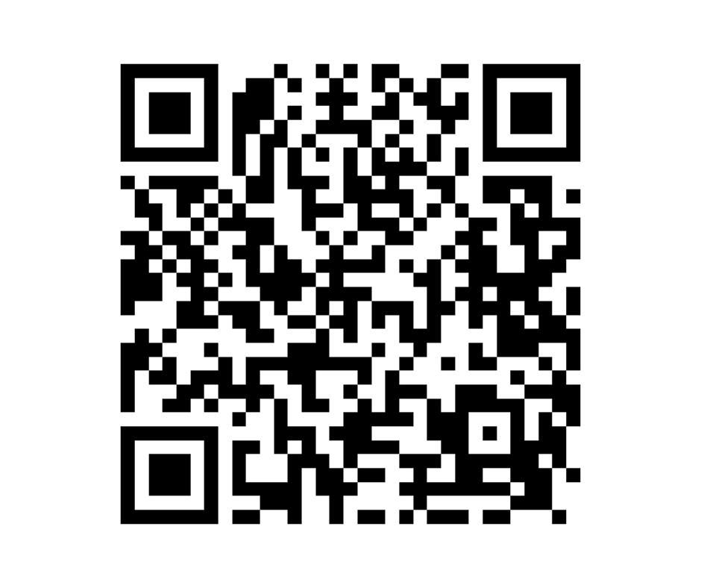
Get more info about your program
Notes:
OzTREKK registration page

Slide 30
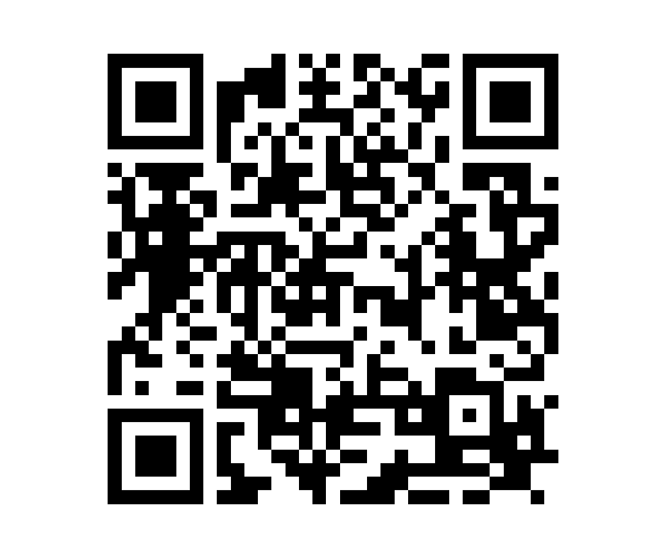
Get more info about your program
Notes:
Ashish’s registration page

Slide 31
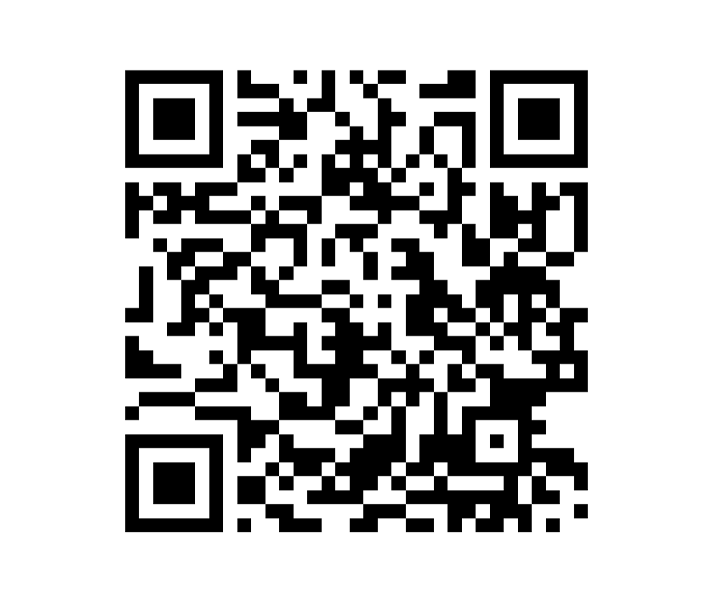
Get more info about your program
Notes:
Casey’s registration page

Slide 32
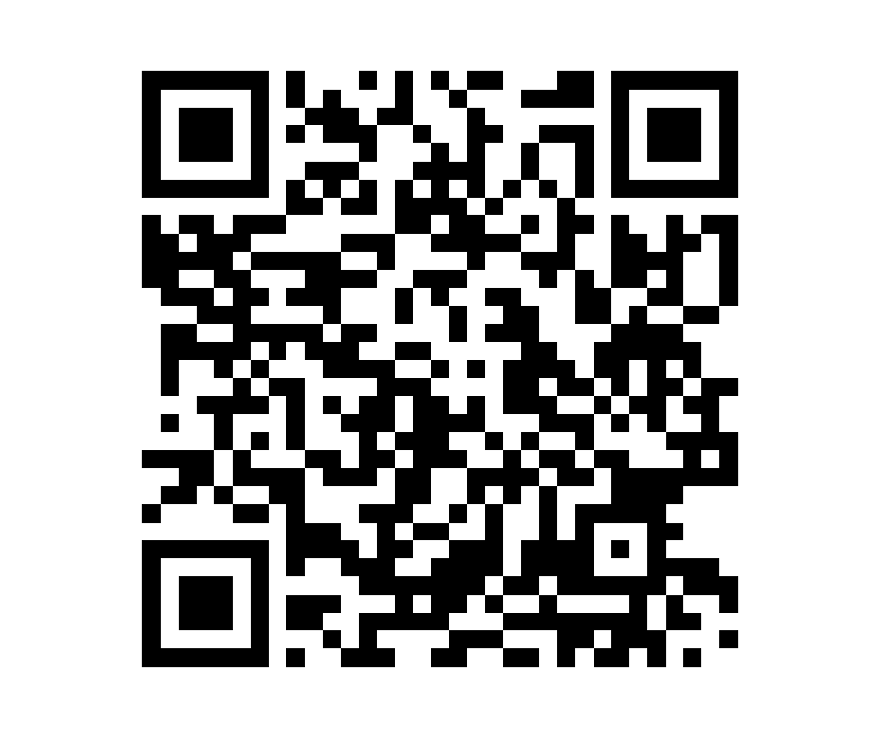
Get more info about your program
Notes:
Sarah’s registration page

Slide 33
Get In Touch!
medicine@oztrekk.com
When you apply through OzTREKK, you can apply to multiple universities at once!
1-866-698-7355
oztrekk.com

Slide 34
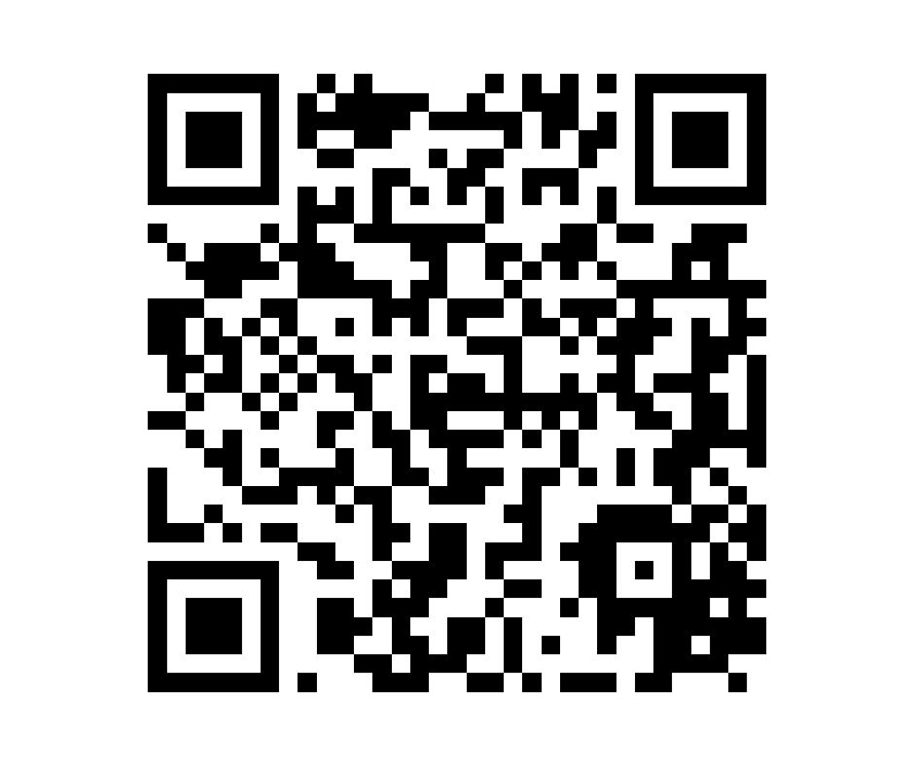
Get more info about your program
Notes:
Sonny’s registration page

Slide 35
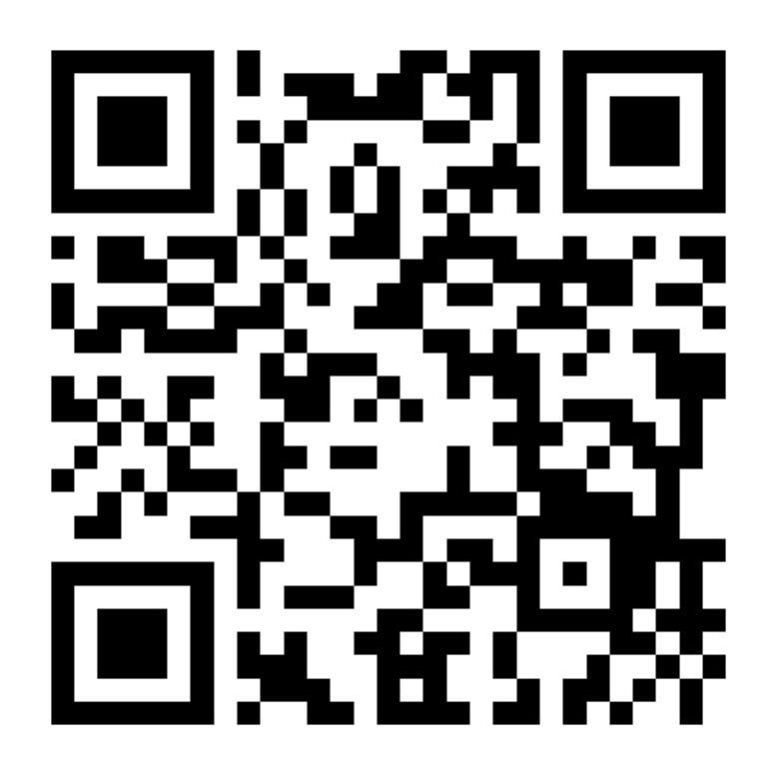
Across Canada Nov. 8 – 13, 2023
Get the
location details

Slide 36
THANK YOU!
medicine@oztrekk.com

Slide 37
Undergraduate & Graduate Entry
10 medical schools
9 options for students in final semester or with completed degrees
6 undergrad options for students applying directly from high school
2 undergrad options for students with partially completed bachelor’s degrees
APPLY FROM HIGH SCHOOL OR FROM UNIVERSITY
Notes:
MD – 4 years
UG – 5 or 6 years
6 of OzTREKK's Australian universities have medicine programs which it is possible to enter directly from high school and lead to an MD or equivalent qualification. These include:
-Standalone single degree medicine programs (JCU and Monash)
-Combined degrees offer a guaranteed pathway to an MD, as entry requirements for both degrees are met at the initial offer stage, and progression through the program is based on passing with a minimum GPA.
-UG programs: Only JCU and Macquarie allow post-graduate studies for entry (i.e., you can’t have any post-secondary studies to enter all the others. High school only and no more than 2 years previous)
***I like to keep my students focused on 5 or less applications at a time. To keep them focused and to make the process as smooth as possible.

Slide 38
Admissions Changes: COVID-19
WHAT WE HAVE SEEN
More applications + reduced seats = more competition
Increase in competitive MCAT score
Increase in competitive cGPA
Interview changes: online or removed
Notes:
*Take-home point: The competition will likely be higher for the 2022 intake. Stay updated.

Slide 39
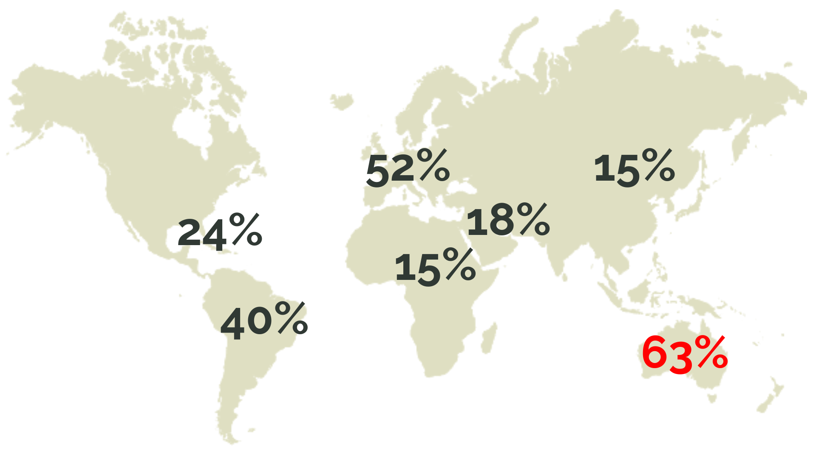
Match Rates

Slide 40
CaRMS
2021 | 63%
2020 | 63%
2019 | 46%
2018 | 53%
2017 | 48%
2016 | 61%
2015 | 63%
2014 | 52%
2013 | 65%
2012 | 72%
54%
5-year average
AUSTRALIAN MEDICAL SCHOOL GRADUATES
SOURCE: www.carms.ca – Tables and Reports (table 50)
Notes:
We can add more stats here later

