Slide 1
HBSU IMSS Princeton Review MCAT Session
Notes:
ENGAGING THE AUDIENCE
According to survey data of students matriculating to medical school, 90% of students who took the MCAT a second time improved their score. Think about that for a second. 90%. These are students who took the necessary prerequisites, have a strong desire to go to medical school, and already took the effort to register and take the MCAT once. Then they decided to take the test again, register and preparing for the MCAT again. Nine out of 10 of these students improved their score. This might convey some special benefit to taking the test again, however you should know that most students do only take it one time.
While these were students must have had a reason to take the test again, their improvement the second time tells you a lot about the MCAT. Students who were able to sit down and know ahead of time what was facing them scored much better. If you have known since you were in the second grade that you wanted to be a doctor, that will not necessarily mean you will get a good MCAT score. If you aced every single MCAT prerequisite you took in college, that will not necessarily mean you will get a good MCAT score. If you have spent an unbelievable amount of time working at a hospital, that will not necessarily mean you will get a good MCAT score.
So what does it take to get a good MCAT score? It takes knowing the right strategies for the MCAT.
https://www.aamc.org/media/38916/download

Slide 2
Free Course Giveaway
Please fill out your raffle cards now! We will collect them from you in about 15 min.
Today’s Raffle includes 2 prizes:
Princeton Review MCAT textbook
A full Princeton Review course (value up to $3649)
PrincetonReview.com
800-2Review
PrincetonReview.com
800-2Review

Slide 3
Contact Information
Kaitlyn Nitta
Campus Representative
The Princeton Review Canada
infocanada@review.com
Ellie Aylward
Outreach Specialist
The Princeton Review Canada
ellie.aylward@review.com
PrincetonReview.com
800-2Review

Slide 4
MCAT Information Session
MCAT Basics
Facts, CBT, Tools
MCAT Sections
Content, Scoring
MCAT Prep Options
Free Events, MCAT 513+ Guarantee Course
PrincetonReview.com
800-2Review

Slide 5
WHAT IS THE MCAT?
Notes:
IDEA #1—Why is the MCAT Crucial?
Our first big idea is: why is the MCAT crucial? I imagine some of you are thinking “I know why the MCATs important. I know all about the MCAT. I want to get right down to understanding individual questions and the strategies I need on specific questions.” But think about a pro athlete. Before an athlete gets down to understanding the specific strategies and approaches for each individual game, they have a lot of big picture questions answered. What are the dimensions of the field? How is this game scored? What is the equipment you need? What are the basic athletic skills required for this game? How long will this game take?
The pro athlete has likely settled these questions well before taking the field. But those questions all must be settled before you get down to specific strategies. So before we breakdown the different sections of the MCAT and before we get into individual questions on the MCAT, we need to all be clear about the layout of the field and the rules of the game. We need to know exactly why the MCAT is so crucial.

Slide 6
Administered by the American Association of Medical Colleges (AAMC) - (www.aamc.org/mcat)
Required for entry into most Canadian medical schools
Computer-based test 7 hours and 30 mins
MEDICAL
COLLEGE
ADMISSION
TEST
Notes:
And we will start with the very basics. The MCAT stands for Medical College Admission Test. In other words, this is the test you must take to get into medical school. That bland statement is more true than you may think.
(Hit Animation #1) The MCAT is administered by the American Association of Medical Colleges, better known as the AMC. This is not a test built and developed by some separate entity from medical schools. The MCAT is not a general test that works for a number of schools, which was later adopted by medical schools. The MCAT is built and administered by the medical schools themselves. The MCAT is a barrier set up by medical schools to be a key part of the medical school admission process.
(Hit Animation #2) And it is not just some medical schools. The AAMC is the accrediting body for all US medical schools. Any medical school that is graduating students who will be doctors is under the umbrella of the AAMC. You can think of them as the medical mafia that controls the entire ecosystem of medical schools. For something to happen at a medical school, or be done by a medical school, the AAMC must sign off on it. And this is the group that administers the MCAT.
(Hit Animation #3) Also, there is basically no such thing as an MCAT-optional medical school. The MCAT is required for every medical school in the US and Canada, with only rare exceptions. Those are usually either Francophile schools in Canada or joint BA/MD programs. You will almost certainly have to submit MCAT scores when you apply to medical school. This is true whether you are seeking an MD or a DO. If you want to apply to a medical school, much less become any sort of doctor, you must first take the MCAT.
https://www.aamc.org/who-we-are

Slide 7
FROM THE AAMC: “The Medical College Admission Test® (MCAT®) is a standardized, multiple-choice examination”
PROBLEM SOLVING
CRITICAL THINKING
KNOWLEDGE
Notes:
And the MCAT is a very specific test. In fact, it is probably fair to say that there is no test quite like the MCAT. You have never seen anything like it if you have never taken a practice test. Here is what the AAMC has to say about the exam themselves: “The Medical College admission test is a standardized, multiple-choice examination.” Sounds straightforward. But they go further and breakdown the other three crucial elements you need to succeed on the MCAT.
(Hit Animation #1) The very first thing that the MCAT requires is problem solving. If a test maker tells you that their exam is standardized, multiple-choice, and requires problem solving, that means you are not just getting questions you can answer simply. You will not be instantly able to identify a right or wrong answer for any question because you are an expert on the question’s topic. You are going to have to figure out what the question is asking and solve the problem of the question to get the right answer.
(Hit Animation #2) The second thing that the AAMC tells you is crucial for the MCAT is critical thinking. This is slightly different than problem solving, but fulfills a similar role when you know what to expect on the test. You will need to make deductions. You will need to understand the relationship between different examples. You will need to be able to see more than what is simply there on the page.
(Hit Animation #3) Finally, the AAMC describes the Medical College Admissions Test as a standardized, multiple-choice examination that requires scientific knowledge. This is actually the thing that makes the MCAT different than any other standardized test you have ever taken. In high school, if you took the SAT or the ACT, you did not need content knowledge. If you have taken other graduate school exams like the GRE, GMAT, or the LSAT, you will be facing tests which are testing skills and do not require test-takers to have specific knowledge. This is not the case with the MCAT. You will need to bring specific scientific knowledge to questions across the test.

Slide 8
The MCAT is offered on select test dates. In 2023, there will be 30 test dates in Canada.
Start time: 8:00am
Registration for Jan-Jun 2023 test dates are now open.
MCAT
TEST DATES
&
REGISTRATION
Notes:
And the way that the AAMC controls the test dates and registration for the MCAT also tells you a lot about what makes the MCAT so crucial. As strange as this may sound, you actually need to think of a strategy for registering for the MCAT. You can think of this as the first barrier to taking the test.
(Hit Animation #1) The MCAT is only offered on select dates throughout the year. You cannot decide that the best time for you to take the MCAT will be between Christmas and New Year's. The test is not offered then. You need to know exactly when the test is offered, which is usually around select weekends between January and September. The MCAT isn’t even offered consistently on the same days of the week. So do not assume just any day in that timeframe has a test date. You must look at the AMC's registration page to know exactly when the test is offered well before you plan on taking the test..
(Hit Animation #2) And you cannot game the system by registering for as many dates as you want. You may only register for one date at a time. The AAMC restricts how many tests you can register for, and even when you can register. The MCAT can only be taken 3 times in one year, 4 times in 2 consecutive years, or 7 times total. This is not a test you can just register for to see how you'll do, and then figure it out after that. The AAMC has made it so you must be absolutely ready to take the MCAT when you register.
(Hit Animation #3) The AAMC even has a rather complicated registration process. For each date, there is a Gold Zone, Silver Zone, and Bronze Zone. The Gold Zone opens up about one month before a test date, the Silver Zone opens up about two weeks before a test date, and the Bronze Zone just one week. These all have different priorities and you want to be in the Gold Zone. This is particularly true if you want to lock in the date you need of those limited test dates.
So before you register for the MCAT, make sure you are absolutely ready for the MCAT.
https://students-residents.aamc.org/register-mcat-exam/register-mcat-exam

Slide 9
Receive scores after approximately 30 days Max score 528, average 500
Can take it a maximum of 3 times in 1 year (4 times in 2 years, and 7 times in lifetime)
Best time to take the MCAT 3rd year of undergrad
MCAT
Scoring
&
Timeline
Notes:
And we will start with the very basics. The MCAT stands for Medical College Admission Test. In other words, this is the test you must take to get into medical school. That bland statement is more true than you may think.
(Hit Animation #1) The MCAT is administered by the American Association of Medical Colleges, better known as the AMC. This is not a test built and developed by some separate entity from medical schools. The MCAT is not a general test that works for a number of schools, which was later adopted by medical schools. The MCAT is built and administered by the medical schools themselves. The MCAT is a barrier set up by medical schools to be a key part of the medical school admission process.
(Hit Animation #2) And it is not just some medical schools. The AAMC is the accrediting body for all US medical schools. Any medical school that is graduating students who will be doctors is under the umbrella of the AAMC. You can think of them as the medical mafia that controls the entire ecosystem of medical schools. For something to happen at a medical school, or be done by a medical school, the AAMC must sign off on it. And this is the group that administers the MCAT.
(Hit Animation #3) Also, there is basically no such thing as an MCAT-optional medical school. The MCAT is required for every medical school in the US and Canada, with only rare exceptions. Those are usually either Francophile schools in Canada or joint BA/MD programs. You will almost certainly have to submit MCAT scores when you apply to medical school. This is true whether you are seeking an MD or a DO. If you want to apply to a medical school, much less become any sort of doctor, you must first take the MCAT.
https://www.aamc.org/who-we-are

Slide 10
Content on the MCAT
BIOLOGY
PHYSICS
GENERAL CHEMISTRY
ORGANIC CHEMISTRY
Biochemistry
Psychology
Sociology
Notes:
And what you need to know for the MCAT isn’t some theoretical body of knowledge. The AAMC very specifically lays out the prerequisite courses students need before taking the MCAT. Not only do they list the courses, but they say how much of each course you need. This is the amount of knowledge you will need to demonstrate on the MCAT. This is not given to you on the exam. This is something you must have in your head when you sit down to take the exam. And, really, it’s a lot.
(Hit Animation #1) The AAMC says you need to take a full year of Biology, Physics, General Chemistry, and Organic Chemistry. While the full year each of Biology, Physics, General Chemistry, and Organic Chemistry does refer to an introductory course, think about your first courses in these subjects in college. How much did you cover in your entire intro Biology course? All of it is fair game to come up on the MCAT. And the same is true for Physics, General Chemistry, and Organic Chemistry. You must be ready with that knowledge as background to answer certain questions on the MCAT.
(Hit Animation #2) But you need all of those yearlong courses, PLUS a semester of Biochemistry, Psychology, and Sociology. If these semester courses were in your very first semester of college and you were a brand new freshman coming to campus, you might need a bit of a refresher on these now.
All of these are prerequisites for the MCAT because the AAMC believes that anyone taking the MCAT must have this scientific knowledge before they even sit down for the test. Think through what that means for a second. This is not the knowledge that a brand-new doctor must have. This is not the knowledge that an incoming medical student must have. This is the knowledge that a student must have before they sit for the MCAT. And the AAMC lists problem solving and critical thinking before knowledge when they discuss what is crucial for the MCAT.

Slide 11
THE ANATOMY OF THE MCAT
Notes:
IDEA #2—THE ANATOMY OF THE MCAT
And that leads us to our second big idea, the anatomy of the MCAT. While we do appreciate the medical reference in saying the anatomy of the MCAT, we also like to discuss the anatomy of the MCAT because the test functions in a very specific, unified manner. You must know exactly how and why it is built, how it functions, and how it all connects to make sure that you succeed on the test. Just as important as knowing a strategy on an individual question, you must know what strategy you will take for the entire exam. To do that, you need to know the anatomy of the MCAT.

Slide 12
MCAT SECTIONS
Chemical and Physical Foundations of Biological Systems (95 minutes, 59 Q’s)
Critical Analysis and Reasoning Skills (90 minutes, 53 Q’s)
Biological and Biochemical Foundations of Living Systems (95 minutes, 59 Q’s)
Psychological, Social, and Biological Foundations of Behavior (95 minutes, 59 Q’s)
Notes:
To understand the anatomy of the MCAT, we should start with what’s on it. The MCAT has four separate sections, which all test different categories of knowledge the AAMC believes you must have in order to succeed in medical school. You might remember we saw those sections while talking about scores, but I’d bet you don’t remember exactly what each section is called. In fact, the MCAT very intentionally describes its sections in complex, interdisciplinary, and particular ways. No section is a straightforward approach to any scientific subject. For example:
(Hit Animation #1)
The MCAT does not have a Chemistry and Physics section. Instead, you will be taking a “Chemical and Physical Foundations of Biological Systems” section. This section does cover chemistry and physics, but also organic chemistry and biochemistry, as well as some basic biology.
(Hit Animation #2)
The MCAT does not have a “Reading” section, but a “Critical Analysis and Reasoning Skills” section. This section is designed to test your comprehension, analysis, and reasoning skills by asking you to critically analyze information provided in passages from a wide range of social sciences and humanities disciplines.
(Hit Animation #3)
The MCAT does not have a “Biology” Section, but a “Biological and Biochemical Foundations of Living Systems” section. This section covers most basic biology topics, as well as throwing in some biochemistry and organic chemistry.
(Hit Animation #4)
Finally, the MCAT does not have a “Psychology and Sociology” section, but a “Psychological, Social, and Biological Foundations of Behavior” section. So you do not need to simply know about Psychology and Sociology, but specifically how they apply to Biology.
These sections all cover more than one area of knowledge. On no MCAT section will you be answering basic questions of fact about science you learned in your college courses. Every single section also has passages related to the general area described by the subject title. The sections all require a little bit of problem solving, critical thinking, and scientific knowledge. If you were literally the best chemistry student in college, that is no guarantee that you will do well on the Chemical and Physical Foundations of Biological Systems. That's not just because you would also need to know some physics. You are being asked to apply that chemical and physical scientific knowledge as a foundation toward biological systems. This is the task in front of you on each section of the MCAT.

Slide 13
THE PRINCETON REVIEW PREPARATION OPTIONS
PrincetonReview.com
800-2Review

Slide 14
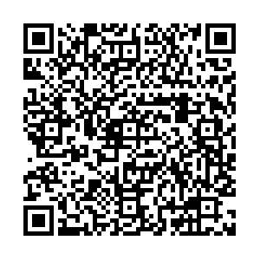
START WITH A FREE PRACTICE TEST
Take an MCAT Practice Test on our website anytime!
Register for free at: www.princetonreview.com/medical/free-mcat-practice-test
Virtual Dental School Symposium TOMORROW!
Wednesday, November 22nd, 7pm-10:00pm EST
Register for free at: www.princetonreview.com/DentalEventsCanada
PrincetonReview.com
800-2Review
PrincetonReview.com
800-2Review

Slide 15
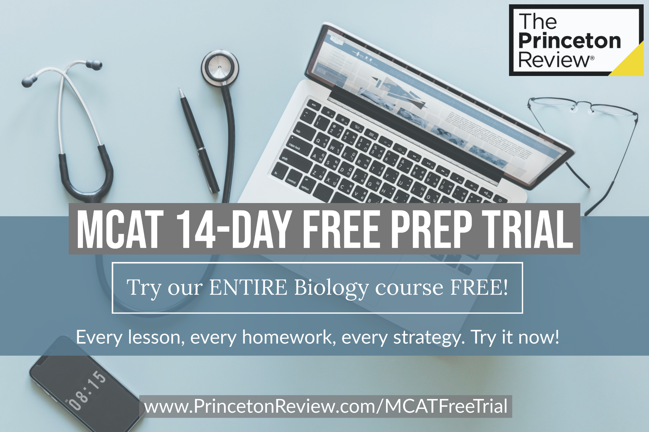
FREE ONLINE RESOURCES
MCAT Free Prep Trial: www.princetonreview.com/MCATFreeTrial
MCAT Flashcards App: www.princetonreview.com/mcat-flashcards-app
PrincetonReview.com
800-2Review
PrincetonReview.com
800-2Review

Slide 16
MCAT 515+ COURSE (our most popular course!)
Score Guarantee – score a 515 or improve 15 points!
168 hours of live instruction (123 lecture hours, 45 Topic Focus hours)
Team of expert instructors – 4 to 6 instructors
16 practice tests (including all AAMC released materials)
Online Tools (Medflix, DrillBuilder, subject specific exams)
Immediate access to online student portal!
The Princeton Review Satisfaction Guarantee
Convenient Schedules
Tuition: $3,649 CAD+tax, In-Person and Online
PrincetonReview.com
800-2Review
PrincetonReview.com
800-2Review

Slide 17
MCAT LIVEONLINE COURSE
Efficient, concise preparation focused mainly on strategies!
40 lecture hours, 90 Topic Focus hours
Team of expert instructors – 4 to 6 instructors
16 practice tests (including all AAMC released materials)
Online Tools (Medflix, DrillBuilder, subject specific exams)
Immediate access to online student portal!
The Princeton Review Satisfaction Guarantee
Convenient Schedules
Tuition: Online $3,199 CAD + tax
PrincetonReview.com
800-2Review
PrincetonReview.com
800-2Review

Slide 18
MCAT ONLINE COURSE
Self-paced package plus access to expert instructors!
90 Topic Focus hours
Access to all online tools (including AAMC materials) and books
Immediate access to online student portal!
Tuition: $2,599 CAD + tax
MCAT PRIVATE TUTORING
Flexible schedule
Tailored Syllabus
10 hour Targeted Package – focus on a specific subject!
Course materials and online tools included
Tuition: 10 hours - $3,200+tax
PrincetonReview.com
800-2Review
PrincetonReview.com
800-2Review

Slide 19
DO YOU LIKE DISCOUNTS?
$900 off TPR BLACK FRIDAY SALE!
(only running for the next 3 days!)
15% off self-paced programs!
15% off private tutoring and admissions counseling!
Email ellie.aylward@review.com for your promo codes!
Enroll at 1-800-2REVIEW or www.princetonreview.com
PrincetonReview.com
800-2Review
PrincetonReview.com
800-2Review

Slide 20
QUESTIONS? CONTACT US!
Kaitlyn Nitta
Campus Representative
infocanada@review.com
/TPRCanada
@TPRCanada
Ellie Aylward
Outreach Specialist | The Princeton Review
ellie.aylward@review.com
1-800-273-8439 x. 5593
@TPRCanada
@TPRCanada
PrincetonReview.com
800-2Review
Notes:
To understand the anatomy of the MCAT, we should start with what’s on it. The MCAT has four separate sections, which all test different categories of knowledge the AAMC believes you must have in order to succeed in medical school. You might remember we saw those sections while talking about scores, but I’d bet you don’t remember exactly what each section is called. In fact, the MCAT very intentionally describes its sections in complex, interdisciplinary, and particular ways. No section is a straightforward approach to any scientific subject. For example:
(Hit Animation #1)
The MCAT does not have a Chemistry and Physics section. Instead, you will be taking a “Chemical and Physical Foundations of Biological Systems” section. This section does cover chemistry and physics, but also organic chemistry and biochemistry, as well as some basic biology.
(Hit Animation #2)
The MCAT does not have a “Reading” section, but a “Critical Analysis and Reasoning Skills” section. This section is designed to test your comprehension, analysis, and reasoning skills by asking you to critically analyze information provided in passages from a wide range of social sciences and humanities disciplines.
(Hit Animation #3)
The MCAT does not have a “Biology” Section, but a “Biological and Biochemical Foundations of Living Systems” section. This section covers most basic biology topics, as well as throwing in some biochemistry and organic chemistry.
(Hit Animation #4)
Finally, the MCAT does not have a “Psychology and Sociology” section, but a “Psychological, Social, and Biological Foundations of Behavior” section. So you do not need to simply know about Psychology and Sociology, but specifically how they apply to Biology.
These sections all cover more than one area of knowledge. On no MCAT section will you be answering basic questions of fact about science you learned in your college courses. Every single section also has passages related to the general area described by the subject title. The sections all require a little bit of problem solving, critical thinking, and scientific knowledge. If you were literally the best chemistry student in college, that is no guarantee that you will do well on the Chemical and Physical Foundations of Biological Systems. That's not just because you would also need to know some physics. You are being asked to apply that chemical and physical scientific knowledge as a foundation toward biological systems. This is the task in front of you on each section of the MCAT.

Slide 21
Princeton Free Course Giveaway
Raffle Time!!
PrincetonReview.com
800-2Review
PrincetonReview.com
800-2Review

