Slide 2
HELLO!
Presenter:
Josh Phillips
Assistant Manager - Admissions
Notes:
Welcome audience. Introduce yourself and your role at SJSM.

Slide 3
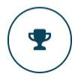
Recognized & Accredited
EDUCATING DOCTORS FOR OVER 20 YEARS.
Our Mission
Fully Accredited medical school
Small class sizes: Average 25-50 students per class
2 Campuses to choose from
Anguilla
St. Vincent and the Grenadines
Notes:
Saint James School of Medicine opened its doors in early 2000’s, and was founded on the principle that motivated students deserve the opportunity to pursue medical school. The founder of SJSM, was a medical school professor who saw many qualified students who were forced to put their dreams on hold due to the excessive costs and overly competitive admissions processes at other medical schools. So he founded Saint James School of Medicine to offer a quality program that anyone who has the drive, determination, and the motivation, at an affordable price.
SJSM is fully accredited by the Accreditation Commission on Colleges of Medicine, which is the highest level or regional accreditation in the Caribbean. Accreditation is the top factor that you should consider when weighing your options for medical school. Attending an unaccredited school would make you ineligible for residency in the US, and will likely not be acceptable in many other countries.
Currently Saint James School of Medicine has about 600 students active in our program. That may seem like a lot, but at SJSM, class sizes max out at approximately 60 students, with the average class size being much closer to 25students, depending on when you start. We offer three starts per year, however the Fall semester (which starts in September), is the only start term available to those students starting in the premed program.
Unique to SJSM, we have two beautiful Caribbean campuses to choose from, which we will cover in more detail later in this presentation.

Slide 4
Internationally Recognized & Accredited
A SCHOOL YOU CAN TRUST.
Accredited by the Accreditation Commission on Colleges of Medicine (ACCM) & the Caribbean Accreditation Authority for Education in Medicine and other Health Professions (CAAM-HP) – the Caribbean equivalents to LCME
Listed in the new World Directory of Medical Schools, which has been developed through a partnership between the World Federation for Medical Education (WFME) and the Foundation for Advancement of International Medical Education and Research (FAIMER).
Recognized by the Educational Commission for Foreign Medical Graduates (ECFMG) in the United States, so students can take the USMLE and apply for ECFMG certification (required for entry into a residency program in the U.S.)
Notes:
The most important thing to consider when researching Caribbean medical schools is accreditation. It is important that your program will allow you to sit for all United States Medical Licensure exams, and later become licensed in the United States.
This slide lists our accreditations and recognitions that allow our students to sit for all licensing exams, gain residency, and practice in the United States.
Now, I would like to take a moment to go over our most important accreditation, which is through ACCM. ACCM stands for the Accreditation Commission on Colleges of Medicine. It is one of the primary accreditation authority in the Caribbean, and is recognized by the LCME, which is the accrediting body for US medical schools. Our accreditation through ACCM shows that a medical education at Saint James School of Medicine is on par with the standards of United States medical schools.
We are also Accredited by the CAAM-HP, which is the other primary accreditation authority in the Caribbean. This makes us one of only 2 medical schools accredited by both the ACCM and CAAM-HP.

Slide 5
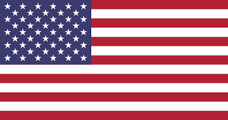
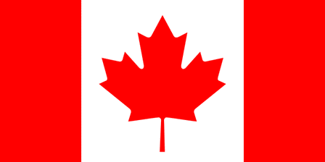
Recognized & Accredited
INTERNATIONAL RECOGNITIONS.
Educational Commission for Foreign Medical Graduates (USA)
Medical Council of Canada
General Medical Council (UK)
Caribbean Association of Medical Councils
Notes:
Here, you can see that your education at SJSM is recognized in multiple countries and regions. Our students are eligible to practice in the US, Canada, the UK, throughout the Caribbean, and in many more countries. Licensure requirements vary between countries, but you can rest assured knowing you will have options upon completion of our program.
Specifically, about 25% of our students hold Canadian citizenship. Because of that, we are recognized by the medical Council of Canada, and SJSM students are able to sit for all Canadian medical licensing exams, obtain residency, and practice in Canada.
Additionally, we are recognized by nearly all provincial government lenders, including OSAP, Student Aid BC, and various others.

Slide 6
Medical School
5 Year Pathway
MD:
MD1 to MD4
16 months
High School Completion
Clinical Sciences:
20 Months
Associates Diploma
Bachelors of Health Sciences
MD5:
Basic Science Review Course
4 months
Doctor of Medicine
Pre-Med:
PM1 to PM4
16 months
Go from secondary school to MD in 5 years
Receive a Bachelors in Health Sciences after 8 semesters (4 semesters of Pre-Med+4 semesters of Basic Sciences)
PM program endorsed by United Nations Development Program
No entrance exam required
Notes:
Now here is a graphic showing the basic five-year timeline you can expect going through our program. So after completing the equivalent of US high school, which would be 10+2 for our Indian students, you would enter our premed program, which is 4 semesters or 16 months. Upon satisfactory completion of the premed program, you will roll into the MD program, which is a total of 10 semesters or 40 months. However, once you’ve completed 4 semesters of our MD program, you will receive a Bachelors in Health Sciences from SJSM that is actually endorsed by the United Nations Development Program. So in 8 total semesters or about 2.5 yrs, you’ll have a Bachelors degree.
You’ll still continue on in the MD program after you get the Bachelors degree, but it’s a nice little bonus you get along the path to your medical degree.

Slide 7
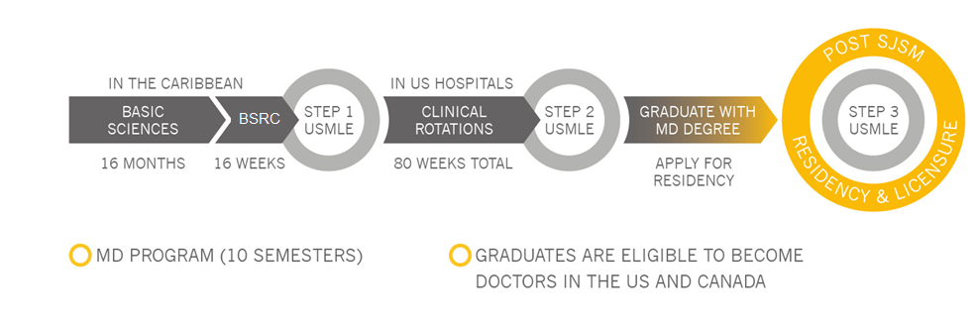
A PROVEN PROGRAM OF SUCCESS.
TIMELINE OF OUR PROGRAM
Notes:
This graphic is similar to the one I just showed you earlier, but this focuses on the 10 semesters of the MD program.
Students begin the program with the Basic Sciences, which consists of 5 semesters on one of our two Caribbean campuses. The Basic Sciences is the classroom portion of our program, which also includes a final semester of preparation for the step one.
In the middle of our program, you sit for the USMLE Step 1. The USMLE Step 1 is the first of three licensure exams required to become a US physician. This test is the most important exam you will sit for, and you’ll need to make sure you pass this exam on your first attempt to ensure your future as a doctor.
The second half of the program is called the Clinical Sciences. This is on-site clinical training completed in our affiliate Hospitals. At the end of the Clinical Sciences you take the USMLE Step 2 and graduate from Saint James with your medical degree. At that point you apply for residency and begin working as a doctor.

Slide 8
A Mission to Help You:
MORE SUPPORT. MORE SUCCESS.
Mission: “Help motivated students realize their dream”
Student-Teacher ratio as low as 10 to 1
Clinically experienced, passionate, and supportive faculty
All faculty hold an MD, PhD or both
Personalized education and mentorship
Tutoring and student mentor programs
Research opportunities
Anatomage 3D medical imaging tables
Notes:
During the Basic Sciences, our curriculum focuses on problem-based learning, with a concentration on the USMLE exam format so that from day one, our professors are training you to do well on the USMLE Step 1.
Passing the USMLE Step 1 on your first attempt is extremely important to enhancing your future residency opportunities. With the USMLE Step 1 changing to pass/fail, there is even greater emphasis on clearing the exam the first time around.
The success of our Basic Science curriculum starts with our accomplished and passionate faculty.
We are a small school, but we have small class sizes with plenty of faculty eager to prepare you for the medical licensing exams. All of our professors are experienced and hold an MD, PHD, or both. We maintain a low student –teacher ratio to make sure our students are supported and able to get a lot of one-on-one time with their professors. Most students develop close relationships with their professors, and they’ll provide advice and career guidance throughout the entirety of the MD program and beyond.
With our large network of clinical affiliates, we often invite esteemed physicians, program directors, colleagues, and Alum to our campuses to provide training and guest lectures for students.
Research is also very important to residency programs and at SJSM we introduce research into the curriculum early. Students are required to conduct their own research and present it to the student body, faculty, and the research committee.
All professors at SJSM are encouraged to conduct independent research. The school funds this research as well as grants for various organizations. This is an excellent way to get involved outside of the classroom and when the research project gets published you get published and is a huge advantage for when you are applying to residency, it really sets Saint James School of medicine students apart.
SJSM students have been published in esteemed medical journals such as Lancet, and we also have our own research publication, SjScience, which can be found on our website.
Finally, Anatomy is one of the most important, foundational courses any medical student will take. In addition to models and computer simulations, we are one of the few medical schools to incorporate Anatomage 3D imaging tables into our curriculum. These tables allow you to understand anatomy down to the cellular level. During these past few remote semesters, our students have not missed a beat in their anatomy education due to the capabilities of these Anatomage tables.

Slide 9
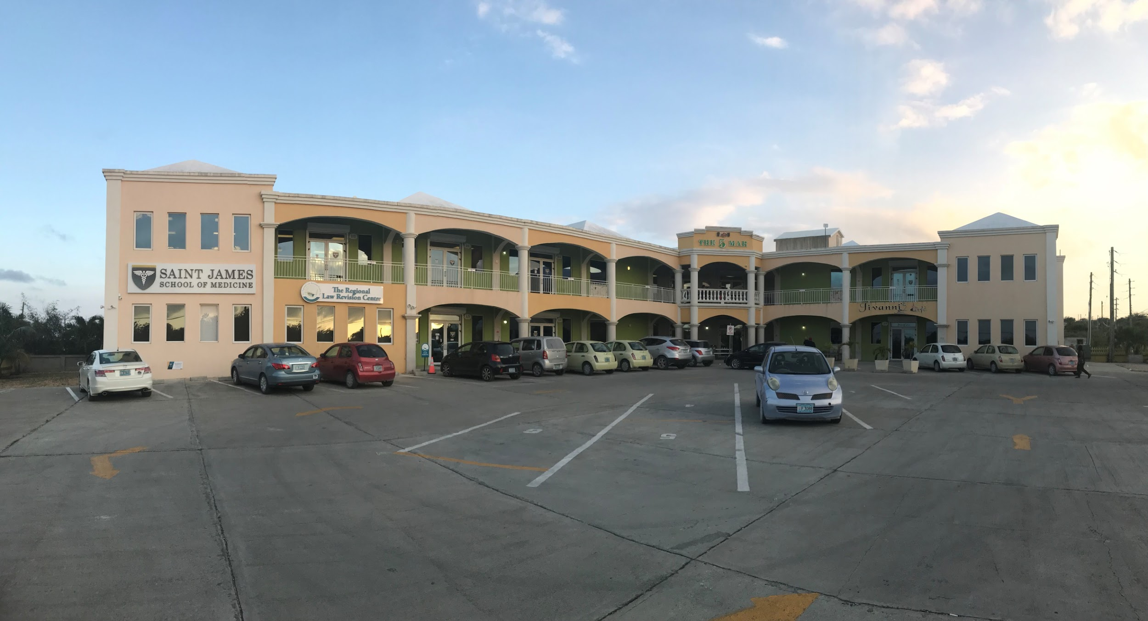
Ideal, supportive community and environment for studying
Thriving music and arts scene
Striking villas and white sand beaches
Notes:
Our campus in Anguilla opened in 2010. It consists of two large school buildings, our Yellow building, shown here features a 7,000 square foot library with private study rooms available for rent. Our other campus building, the White Building, contains our labs and administrative offices.
The SJSM campus is centrally located on Anguilla making it easy to access from all points, and is conveniently located across from JW Proctor’s, a fully stocked grocery store with a deli. Other lunch options on campus include an Asian restaurant, as well as bakery around the corner.

Slide 10
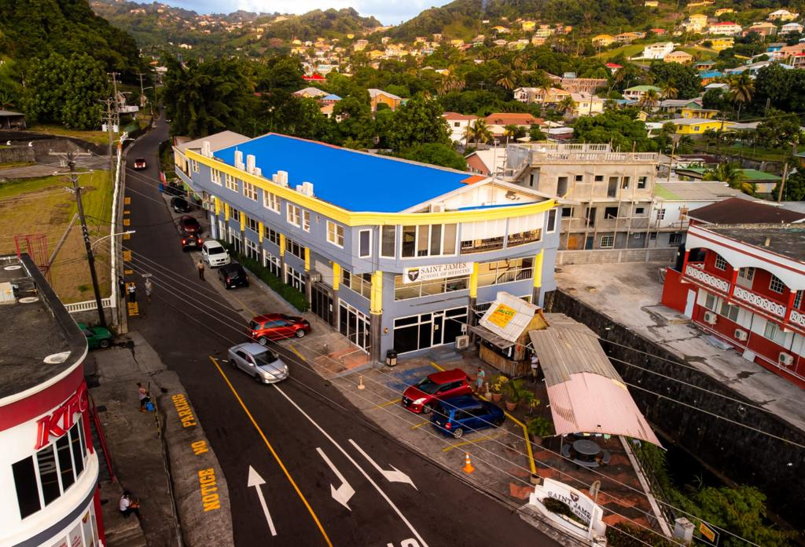
Campus integrated into and supported by the local community
Stunning landscapes to explore by land, air or sea
Notes:
Our St. Vincent campus is centrally located where the three main roads on St. Vincent meet. The campus building is three stories tall with lots of windows and has been recently expanded to include additional study and lounge space.
On campus amenities include study rooms, student lounges, and a library. There is a food shack right in front of the campus and the corner next to campus has an excellent grocery store, a smoothie bar, as well as a fast food restaurant!

Slide 11
Notes:
Now I want to talk a bit about moving to the island.
Saint James School of Medicine provides a specialized enrollment team to assist you with your move to the Caribbean. We are here for you the entire way, and the immigration process is simple and easy to complete. Your Admissions Team, your Advisor and your Document Specialist are ready and available to answer your questions to make sure you are completely prepared.
We have a student Buddy Program, which is a group of student volunteers who will reach out to you before you start classes to give you information and advice.
Additionally, we have our campus concierge who will introduce you to the island and campus, help you plan travel, help you find accommodations, and get you ready for your move.
Between the Buddy Program and our concierge, we will make sure your move is stress free as possible!

Slide 13
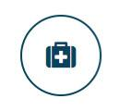
MD Program
CLINICAL ROTATIONS. YOUR DREAM IS CLOSER.
Hands-on clinical experience in U.S. hospitals with ACGME-approved residency programs
Logbooks: Gain the right experience
Personalized guidance from the clinical faculty and staff
Develop skills and networking opportunities for residency
Notes:
All of our clinical rotations are done at Green Book Hospitals. Green book hospitals are ACGME-approved teaching hospitals that have residency programs. This is very important, and I will come back to it later.
At SJSM, we have a Department called the ODCS, which is our Office of the Dean of Clinical Sciences, and they are very involved during your clinical rotations, making sure you are doing what you need to do to gain the residency you are looking for at the end of the day.
During Clinicals you will be using Logbooks. Logbooks are the requirements that each student must complete before they can move on to the next clinical rotation, and must be signed off on by their preceptor. The requirements are the experiences and teaching opportunities every student should be having, like, observing the birth of a baby during an OBGYN rotation, to ensure that every SJSM student has the same experience no mater what hospital they do their clinical rotation at.

Slide 14
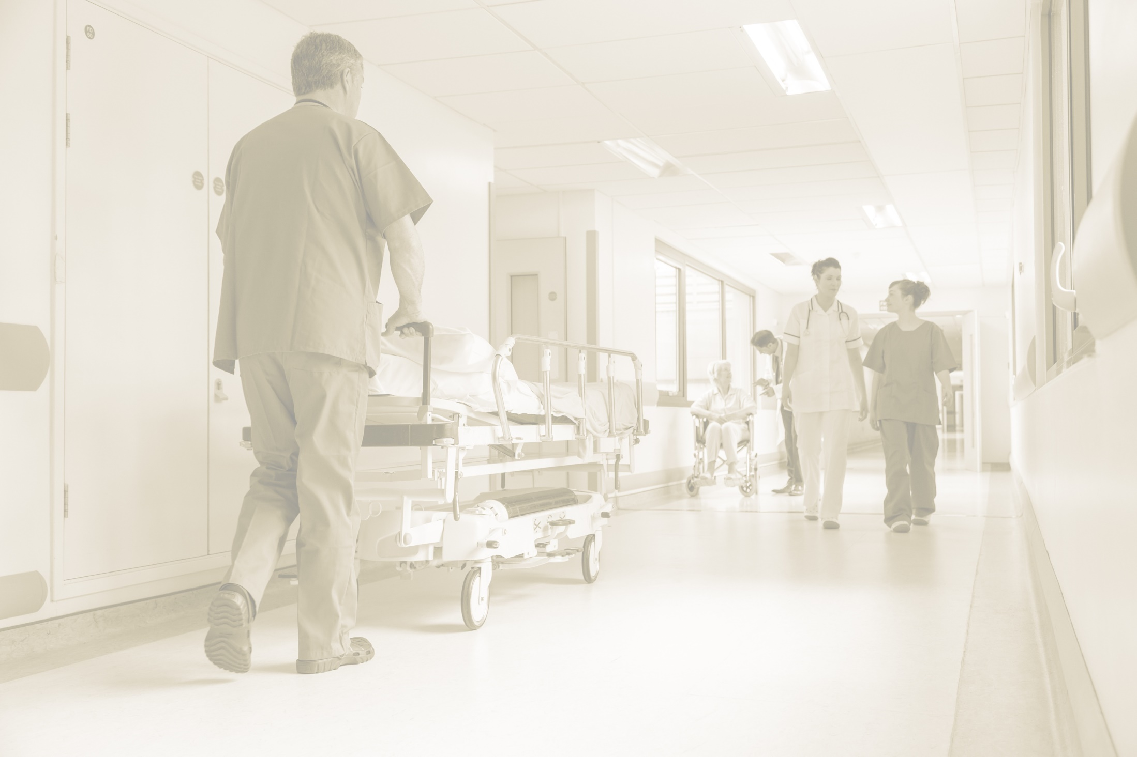
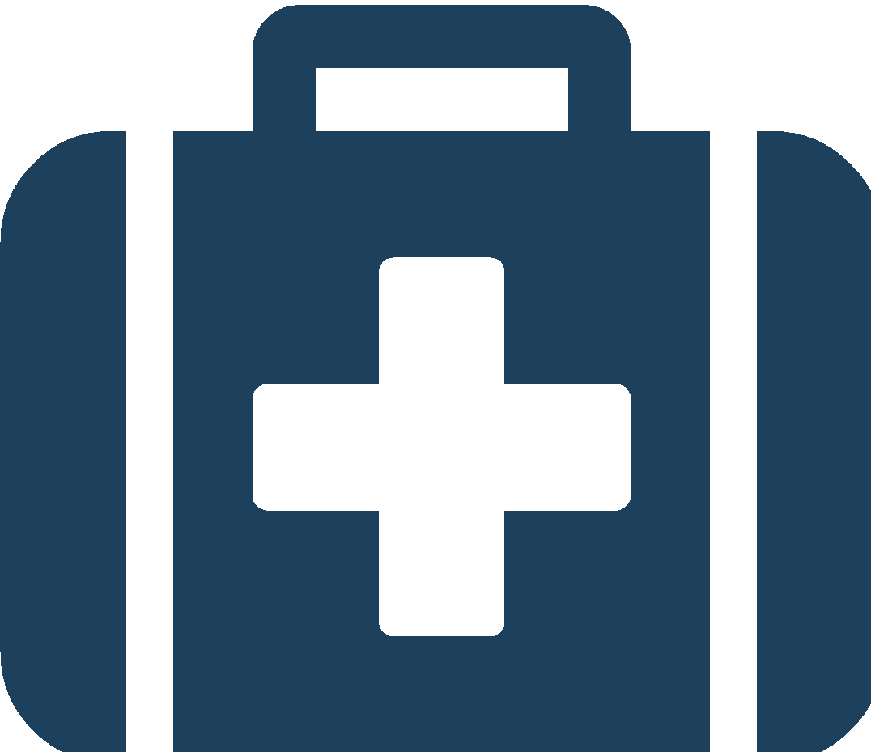
Clinical Sciences
CLINICAL ROTATIONS
CORE | ELECTIVE
Guaranteed | ACGME-approved sites
Set up for you | Residency Prep
ACGME approved sites | Specialty emphasis
Green Book Hospitals | On-the-job interview
Electives are important!
Leverage for your advantage
Get yourself noticed in a positive manner
Use every advantage that you possibly can
Notes:
So, your clinical rotations themselves are divided into two types, Core rotations and elective rotations.
Core rotations are the same for everyone, they are a requirement. There are 6 core rotations, which include Family Medicine, Internal medicine, Surgery, OBGYN, Psychiatry, and Pediatrics. These core rotations will cover your first 48 weeks of the clinical portion of the program.
After you’ve completed your core rotations, you move onto elective rotations, which you can choose based on your future goals. You spend a total of 32 weeks doing elective rotations. This is a great opportunity to experience specialties you are interested in, and especially network. Electives can be great ways to make connections that will help you gain residency later. We often see students obtaining residencies at hospitals they rotated in, that’s why its so important to treat every clinical like a job interview, do your best, and show everyone that you will make a great doctor someday.

Slide 15
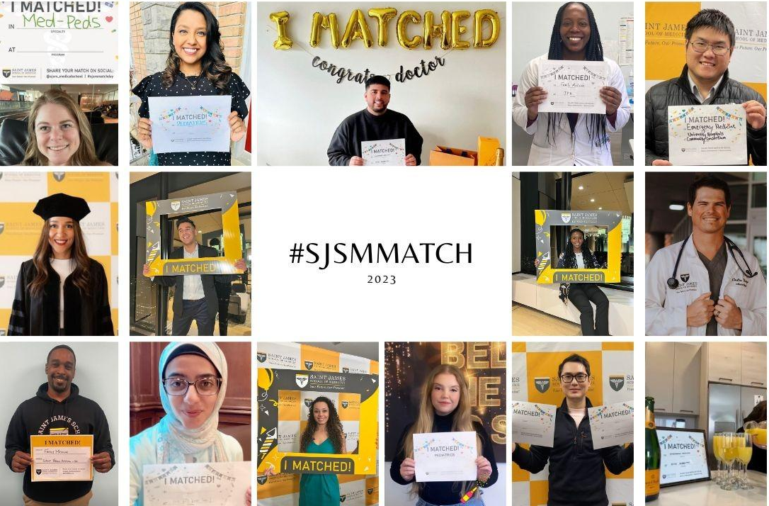
Notes:
Here are some posts from our graduates who were excited to learn about their Match success.

Slide 16
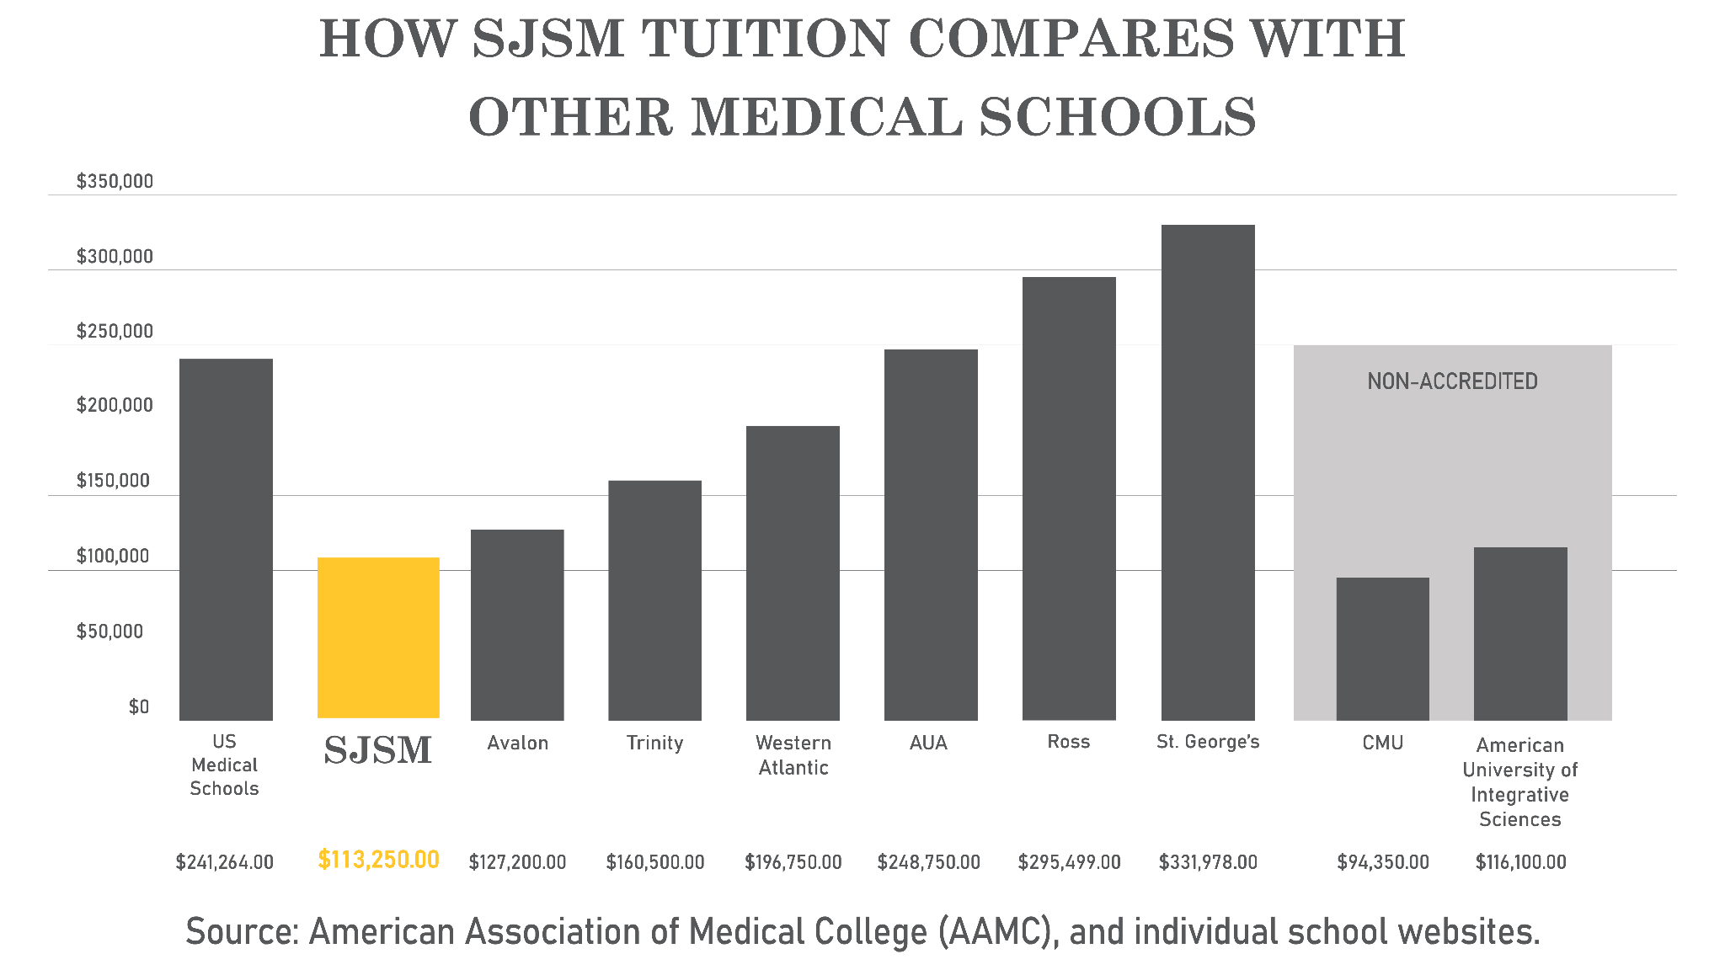
Four-Year Tuition & Fees
Notes:
Now this graphic here is to show you how SJSM compares to other schools in terms of tuition cost. Obviously, attending US medical school costs significantly higher then attending SJSM. More than double the cost of our program. But whats even more surprising is that there are other Caribbean schools that are more than triple the cost of our tuition. And when you attend these schools, you are still an international medical graduate. So it doesn’t make sense to absorb that type of debt.
As you can see, SJSM is among the lowest cost options for your medical education. On this graph, you’ll see a few schools with comparable tuition costs to us, however it’s important to note that those schools are not accredited. As we discussed earlier, accreditation is among the most important factors to consider and graduates of unaccredited medical schools will not be able to be certified to take the USMLE examinations and apply for US residency.

Slide 17
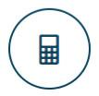
SJSM Tuition & Fees
CHOOSE A CAMPUS TO FIT YOUR BUDGET.
Pre-Medical Program
St. Vincent= $6,500
Basic Science Program
Anguilla = $11,150 per semester
St. Vincent = $9,150 per semester
Clinical Science Program
$13,500 per semester
Notes:
And here is the cost per semester per campus to give you a better idea of the cost. The top portion is the MD1-MD5 on the island and the second portion is what you will be paying for clinical rotations in the US.

Slide 18
Q&A
Notes:
SWITCH PRESENTERS –
Presenter 1: Thank you’s, I’d like to introduce my colleague, I will be available after the presentation for questions.
Presenter 2: Welcome, Introduction, and role at SJSM.

