Slide 1
UMHS: A quality alternative
Legacy of excellence and integrity – Family owned school
Traditional curriculum structure​
Top faculty from US & Canadian med schools​
State-of-the-art campus ​
94% first-time STEP 2 pass rate, average score of 231​
Excellent residency placements​
96% student retention rate​
Low student-to-faculty ratio
Small class size
Personalized medical education
Notes:
Dr. Ross and President Ross emphasized student success, low attrition and low tuition immediately from the inception of UMHS. This is more than just a legacy. It is about outcomes. As you can see, we have a 93% STEP I Pass Rate and a 96% student retention rate. We maintain small classes and our outcomes are proof that it works.

Slide 2
Notes:
Histology, pathology, and many other courses take place in the innovative 210-seat auditorium (picture on the left), which is equipped with 56" LED monitors, high definition LCD projectors, an ELMO® presenter, Sympodium, Projection microscopes, and additional equipment designed to enhance the instructor’s presentations.

Slide 3
11K
6:1
square-foot anatomy building
cadaver ratio
(comparable to US schools)
Anatomy building
Notes:
Our 11,000 square-foot anatomy building, equipped with state-of-the-art audio-visual equipment, is home to both the gross anatomy and neuroanatomy laboratories. The gross anatomy lab is furnished with approximately 20 dissection platforms. Students have a six-to-one cadaver ratio in gross anatomy and a four-to-one cadaver ratio in neuroanatomy. During class, a prosected cadaver is utilized for demonstration purposes. A high-resolution camera captures the tiniest of details and projects out to the 55” LED monitors that are stationed at the end of each student’s cadaver work table.
***Have the student share their experience***

Slide 4
Fifth semester
Portland, Maine​
Prepare to transition into Clinical Science Program​
Introduction to Clinical Medicine II ​and board review​
Begin clinical immersion​
1:1 work with physician preceptors who mentor students​
Work in local hospital and clinics​
Notes:
The fifth semester consists of two required courses: Introduction to Clinical Medicine II and Biological Basis of Clinical Medicine along with a 15 week integrated with live lectures. Students complete the 5th semester they are prepared to sit and pass USMLE Step 1 and seamlessly transition into the clinical program.
***Have the student share their experience***

Slide 5
Clinical clerkships in North America
California
San Bernardino Behavioral Health
Canada
Ontario Shores Centre for Mental Health Sciences
Connecticut
Danbury Hospital, Danbury
Griffin Hospital, Derby
St. Mary's Hospital, Waterbury
Florida
Larkin Community Hospital, South Miami
Keralty Hospital, Miami
Southern Winds Hospital, Hialeah
Georgia
University Hospital, Augusta
Georgia Regional Hospital, Atlanta
Illinois
Weiss Memorial Hospital, Chicago
Maryland
Sinai Hospital of Baltimore
Michigan
Ascension Providence Hospital, Rochester
DMC Huron Valley-Sinai Hospital, Commerce Township
DMC Sinai Grace Hospital, Detroit
McLaren Macomb Hospital, Mt. Clemens
McLaren Oakland Hospital, Pontiac
New York
Montefiore New Rochelle Hospital
Southampton Hospital
Oklahoma
Griffin Memorial Hospital, Norman
Puerto Rico
Ponce Health Sciences University, Ponce
Puerto Rico Women and Children’s Hospital, Bayamon
San Juan City Hospital
Notes:
And here they are listed...you can also find this listed on our website.
Count to 5 before you move to the next slide

Slide 6
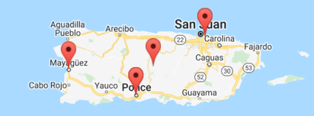
Clinical clerkships: electives
Notes:
This map gives you a visual to where our ELECTIVE rotations are located.
***Bring in a panelist to talk about their experience***

Slide 7
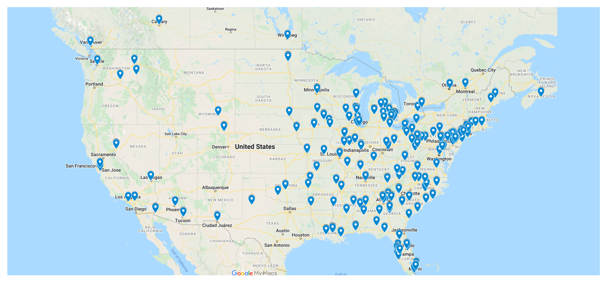
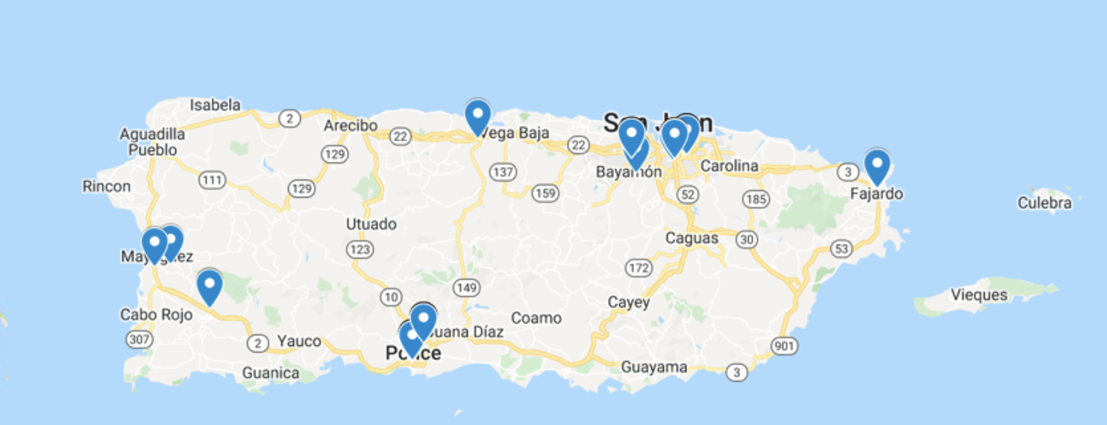
90% Match Rate 2023
Residencies throughout North America
Notes:
Count to 15 before you move from this slide…let the audience take this in.

Slide 8
Our value
High academic standards​
Personalized education​
96% student retention​
Dedicated faculty​
State-of-the-art campus​
20+ teaching hospital affiliations ​
94% pass rate on USMLE Step 2 with ​an average score of 231​
100% pass rate on the MCCQE Part I​
Excellent residency placements ​
Affordable tuition​
Comprehensive financial aid options​
International service-learning opportunities​

Slide 9
Geneviève Gagné
Associate Director of Admissions
Notes:
I am going to leave this slide up for a moment; feel free to take a screenshot so you have our information as well!

